Slide 1
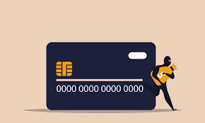
Find Default (Prediction of Credit Card fraud) (Report)

Slide 2


About Credit Card frauds…..
Credit card fraud is one of the most common online scams. credit card numbers, pins, and security codes can be easily stolen and used to make fraudulent transactions. this can cause huge financial losses for traders and consumers. however, credit card companies are ultimately obligated to reimburse their customers for any losses. therefore, it is extremely important that credit card companies and other financial institutions can detect fraud before it occurs.

Slide 3
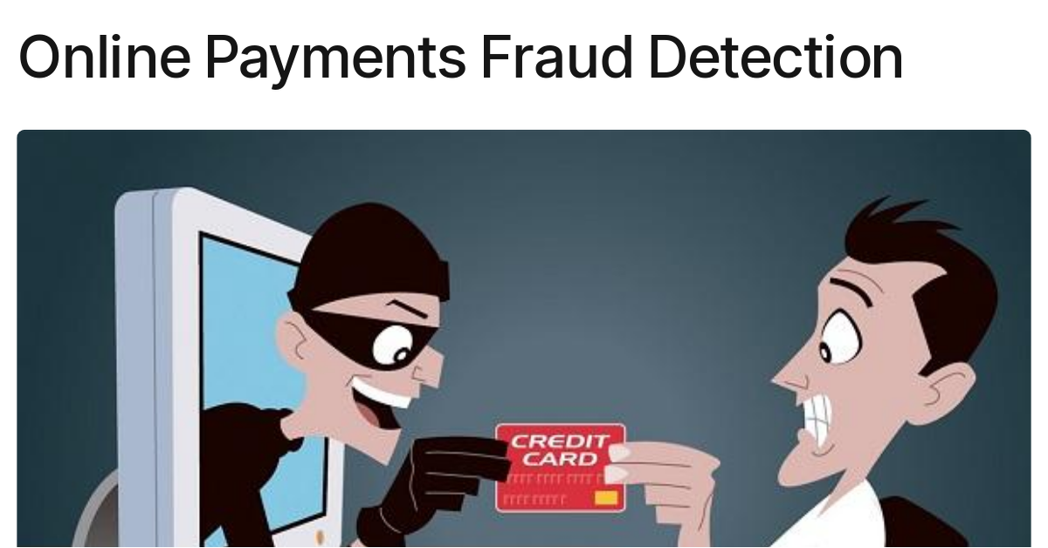

Problem Statement…..
A credit card 💳 is one of the most used financial products to make online purchases and payments. Though the Credit cards can be a convenient way to manage your finances, they can also be risky.
Credit card fraud is the unauthorized use of someone else's credit card or credit card information to make purchases or withdraw cash. It is important that credit card companies are able to recognize fraudulent credit card transactions so that customers are not charged for items that they did not purchase.
The dataset contains transactions made by credit cards in September 2013 by European cardholders. This dataset presents transactions that occurred in two days, where we have 492 frauds out of 284,807 transactions.
We have to build a classification model to predict whether a transaction is fraudulent or not.

Slide 4
About the Dataset….
It contains only numerical input variables which are the result of a PCA transformation. Unfortunately, due to confidentiality issues, we cannot provide the original features and more background information about the data.
Features V1, V2, … V28 are the principal components obtained with PCA, the only features which have not been transformed with PCA are 'Time' and 'Amount’.
Feature 'Time' contains the seconds elapsed between each transaction and the first transaction in the dataset. The feature 'Amount' is the transaction Amount, this feature can be used for example dependent cost-sensitive learning.
Feature 'Class' is the response variable and it takes value 1 in case of fraud and 0 otherwise.

Slide 5
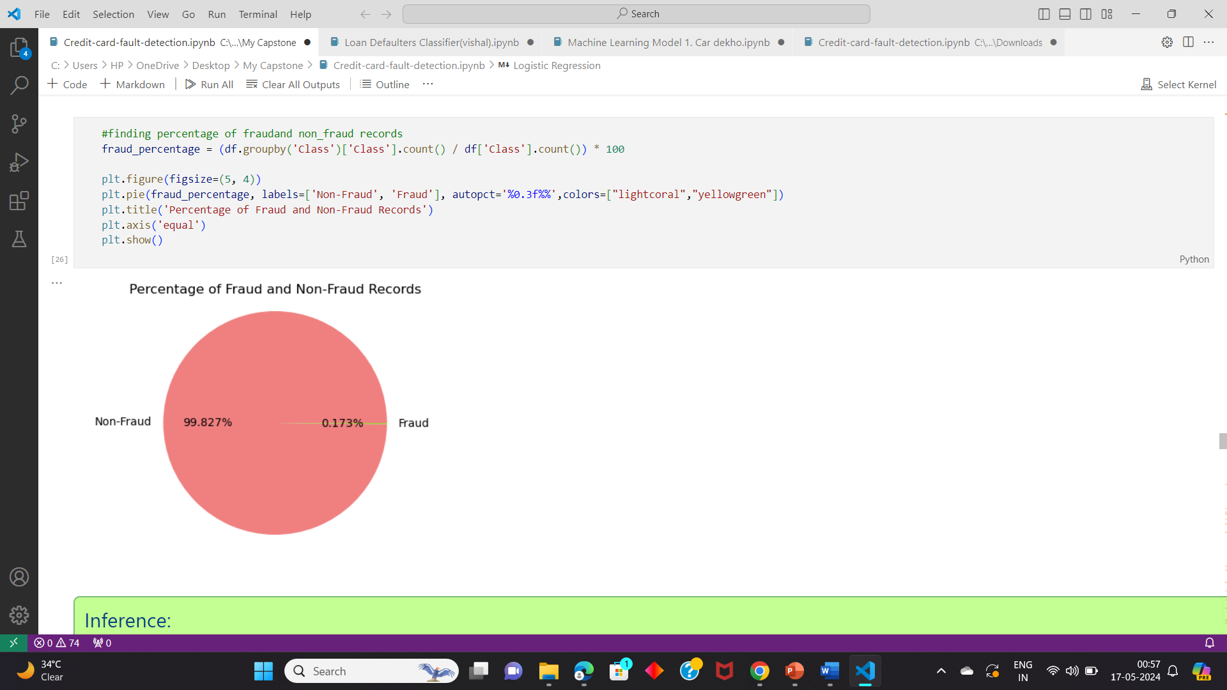
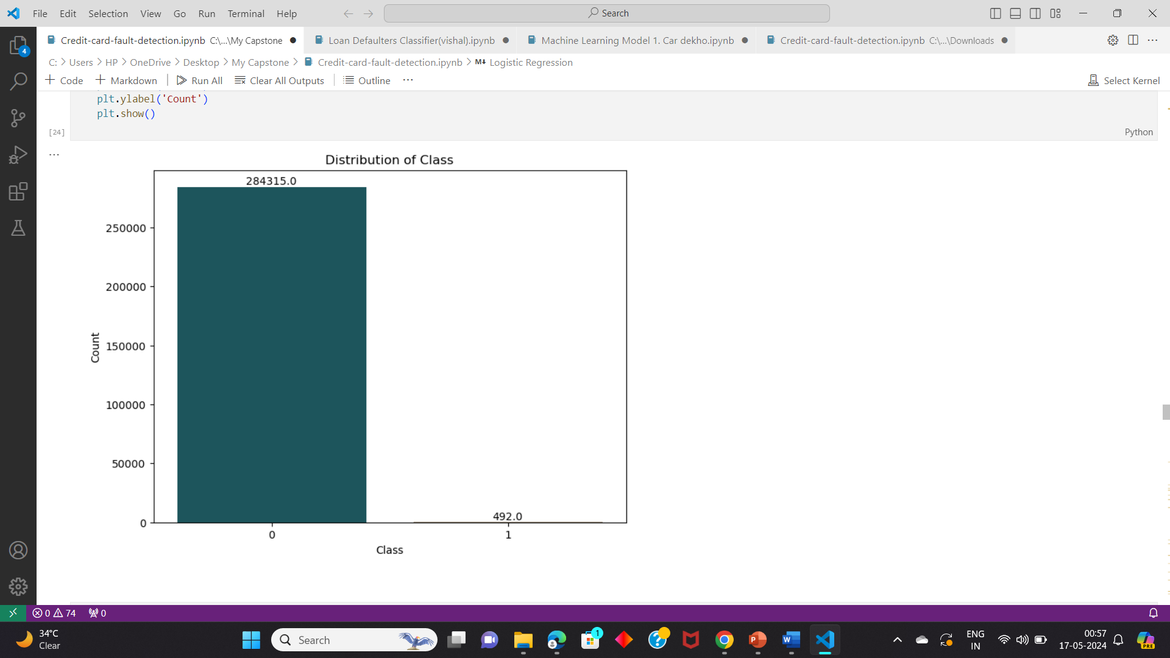
Major Challenges to be faced…..
The dataset is highly unbalanced, the positive class (frauds) account for 0.172% of all transactions.
We need to check the time of fraud transactions occurred.

Slide 6

Model Pipeline….
Data understanding and exploring.
Exploratory data Analysis (EDA).
Data Preprocessing.
Handling imbalanced data.
Splitting the dataset into test and train.
Model Building.
Conclusion.

Slide 7
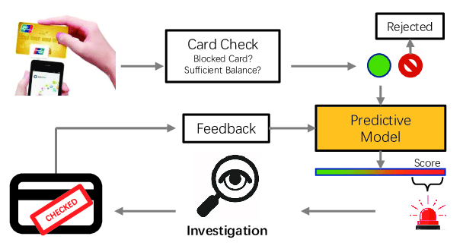
Credit Card Fraud Detection….

Slide 8
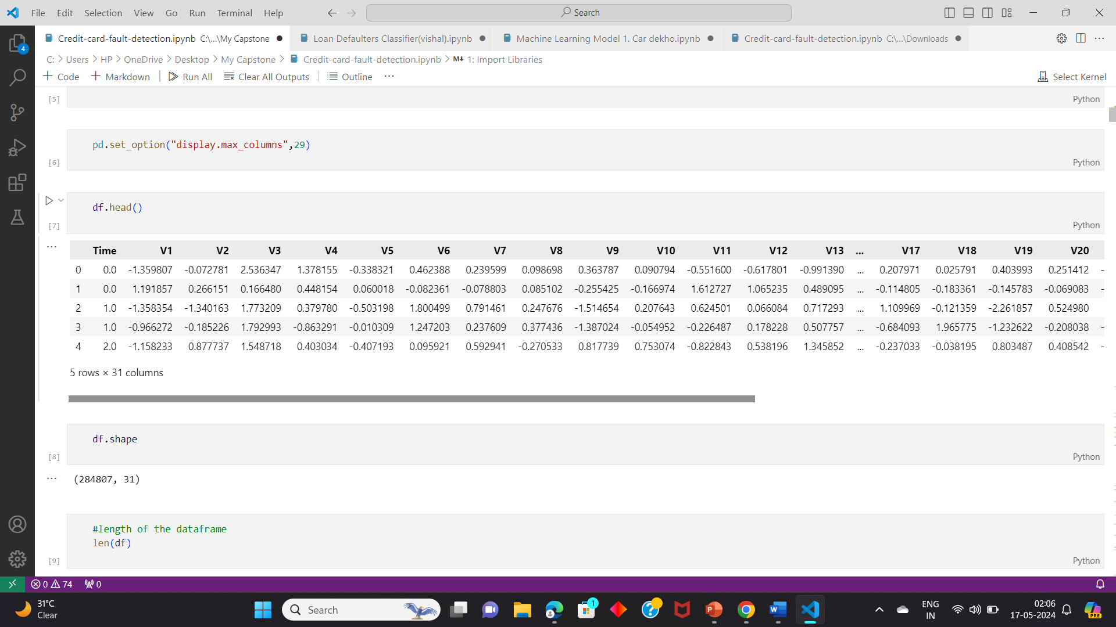
Data Understanding and Exploring….
Read Dataset.
Info of the dataset.
Descriptive Statistics.

Slide 9
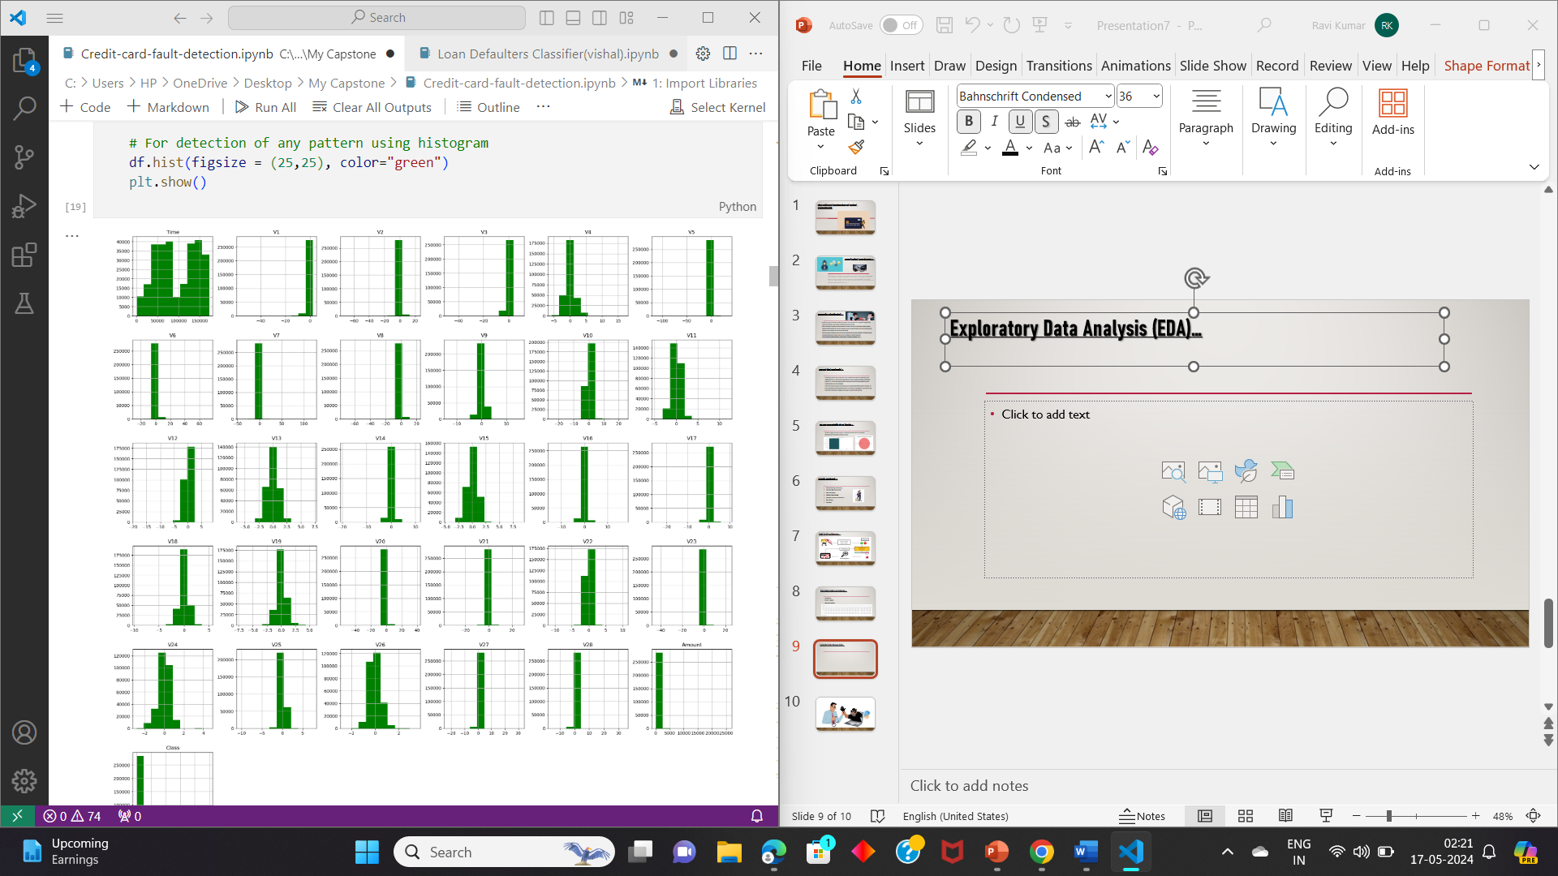
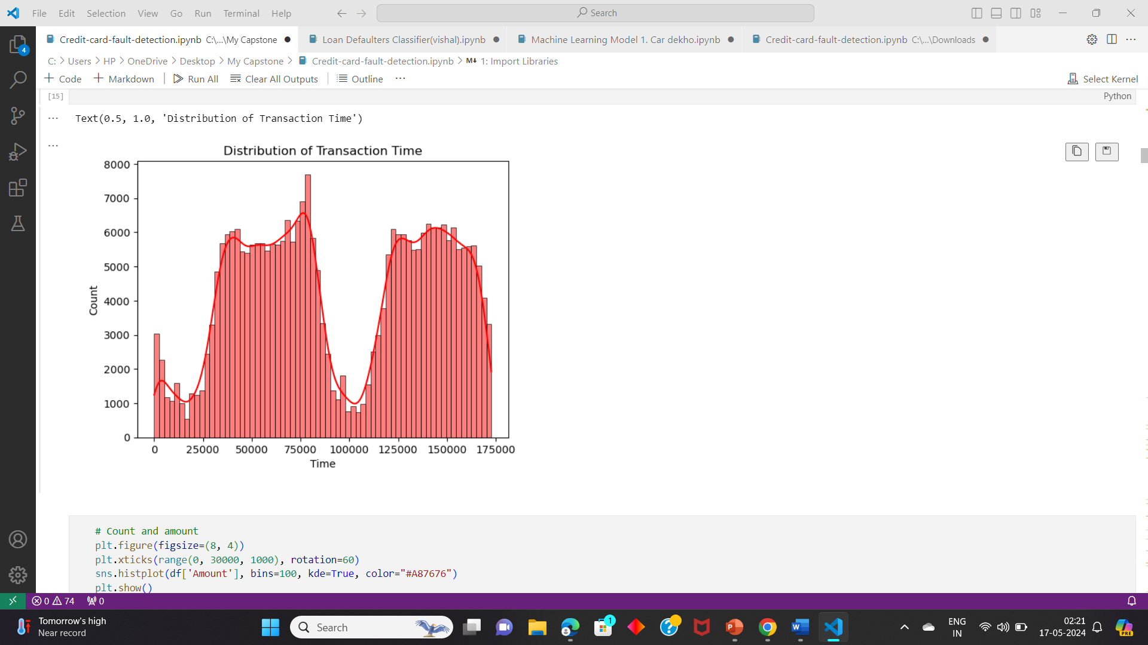
Exploratory Data Analysis (EDA)…
Univariate analysis .
Bivariate analysis .

Slide 10
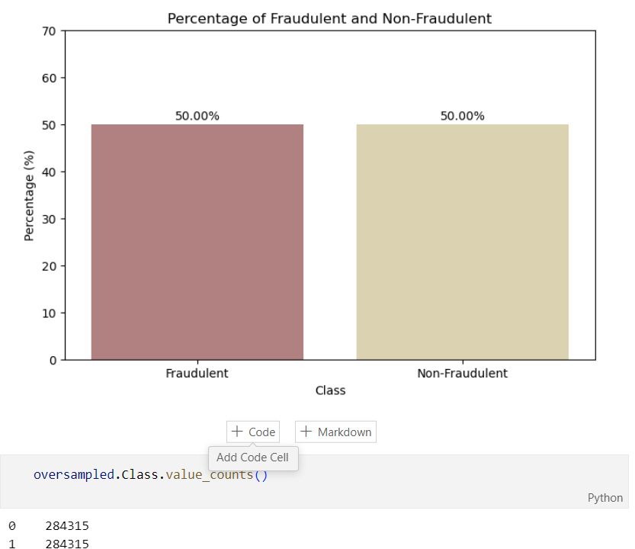
Data Preprocessing….
Checking for Outliers
Missing Value Treatment
Handle imbalanced data.
After using SMOTE the data is now oversampled and balanced.

Slide 11
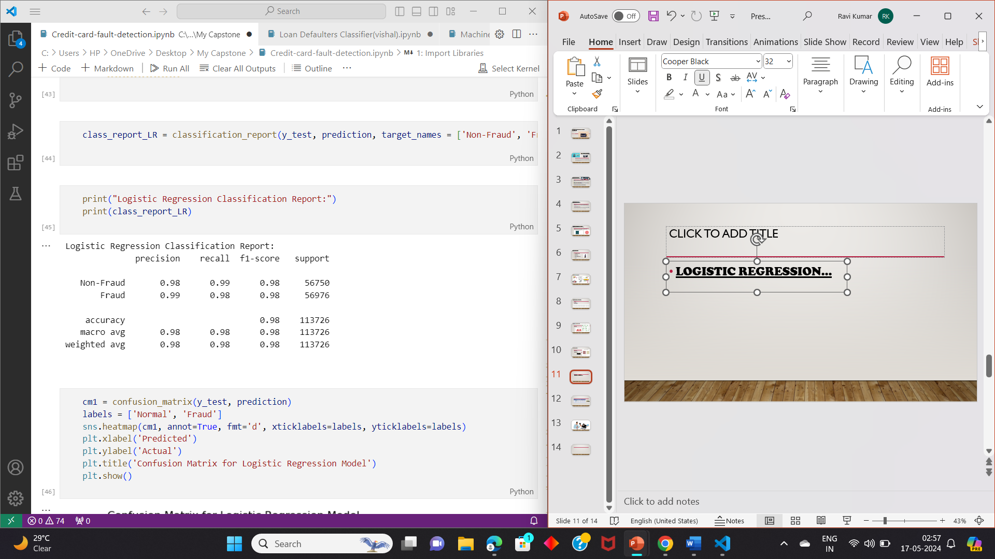
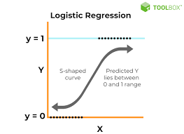
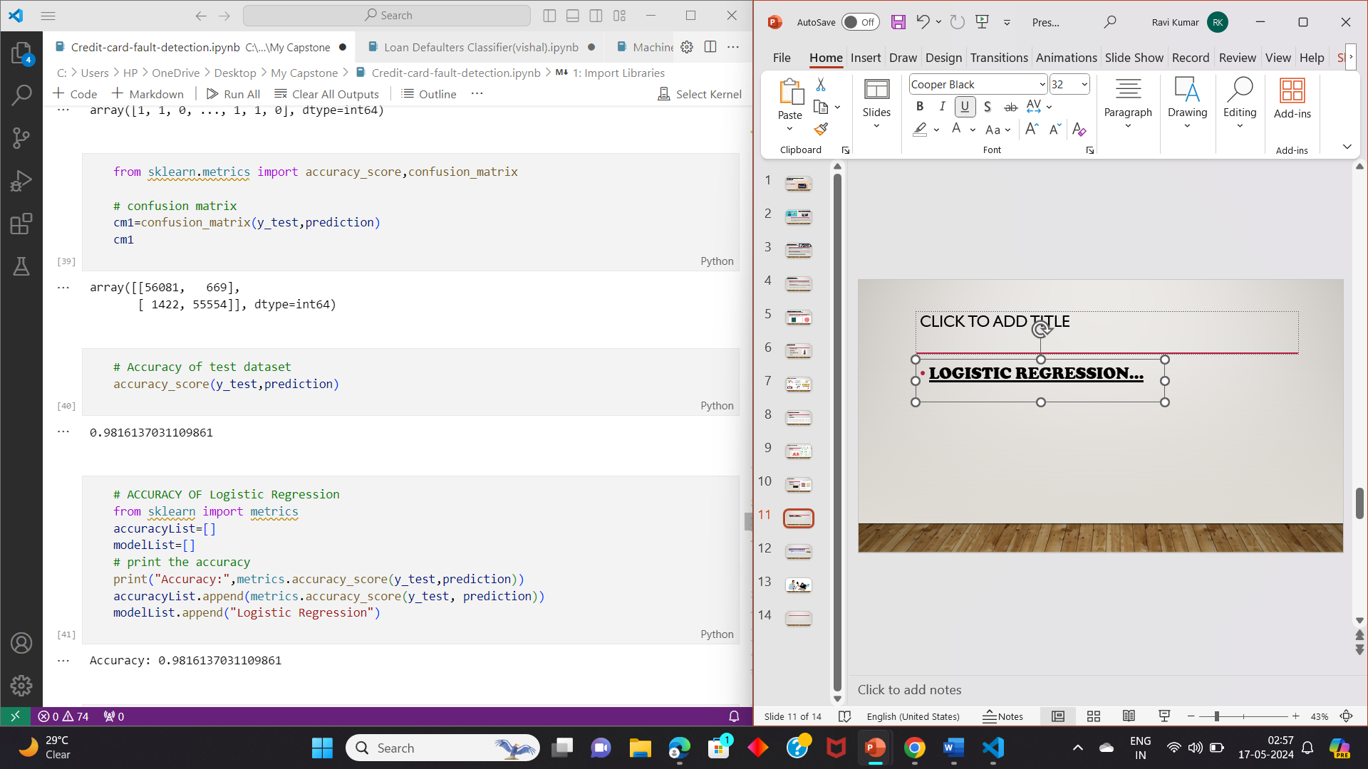
Model Building….
Logistic Regression…

Slide 12
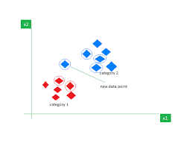
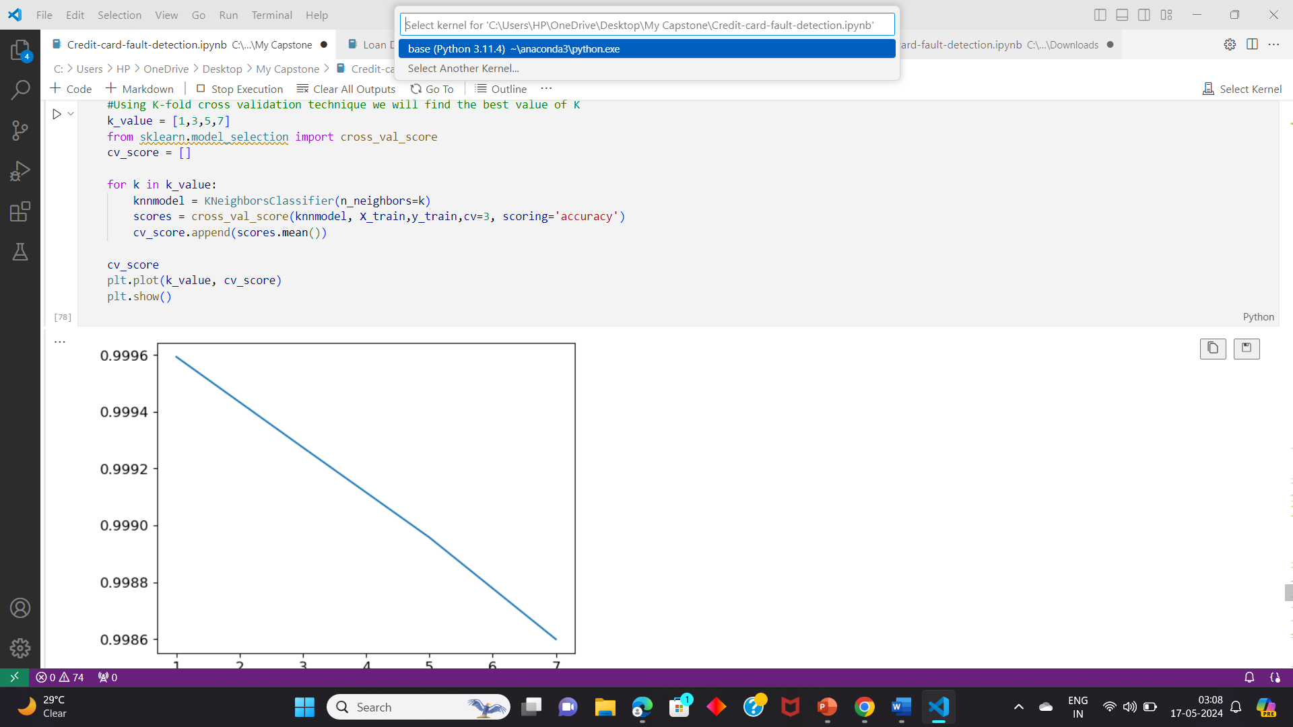
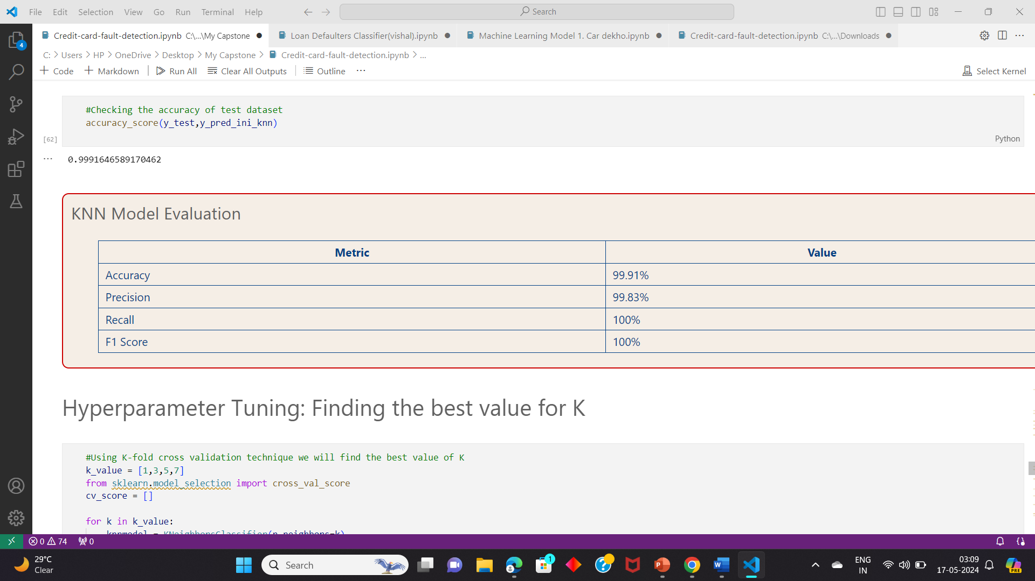
KNN Model…
Hyperparameter tuning for the best value of K.

Slide 13
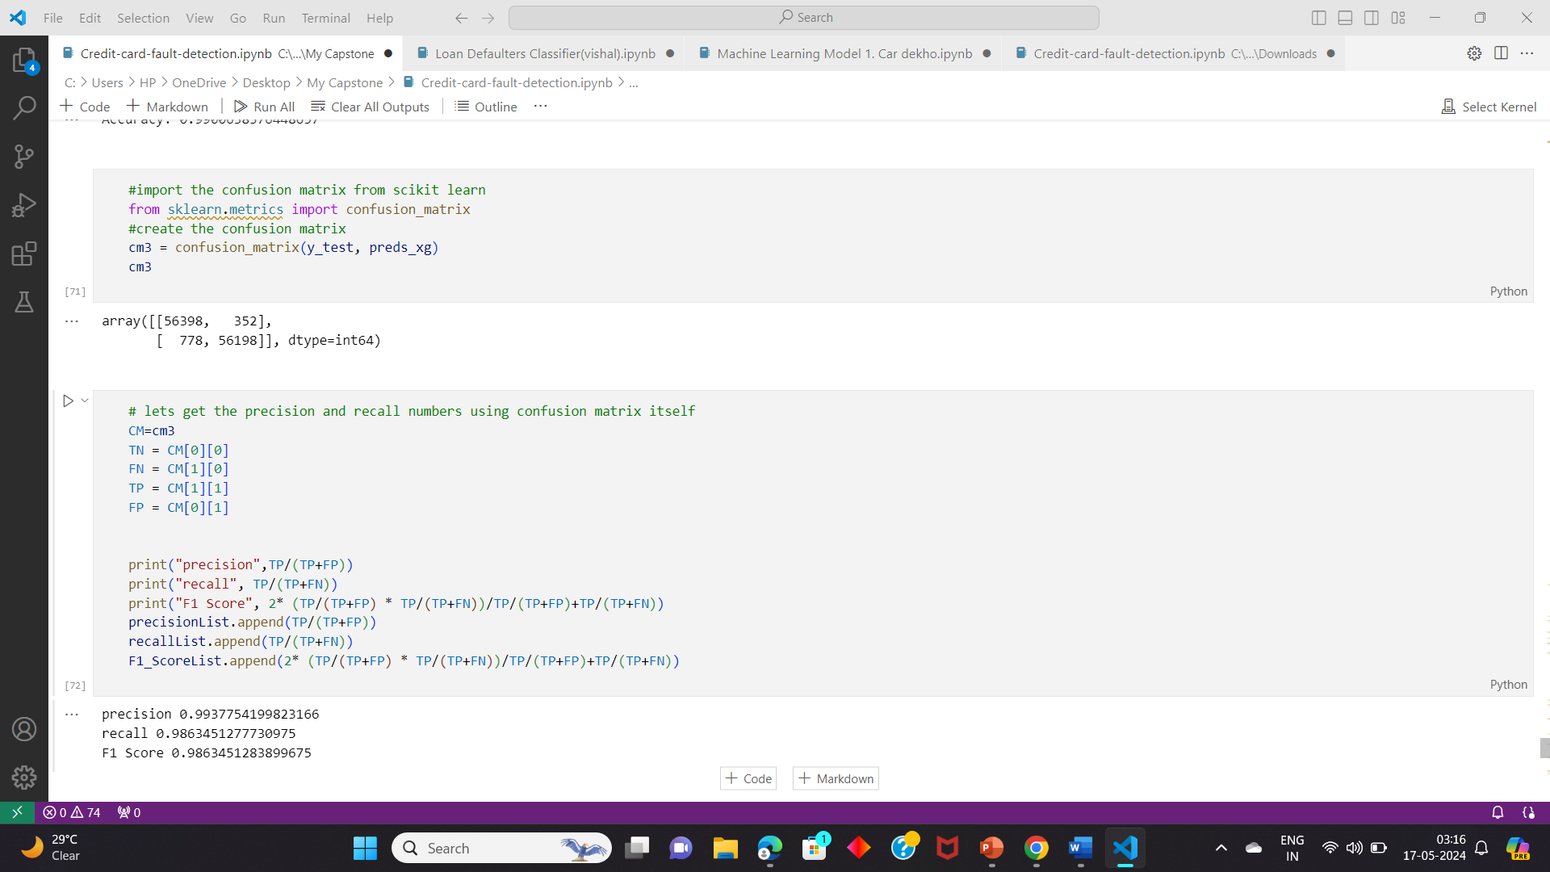
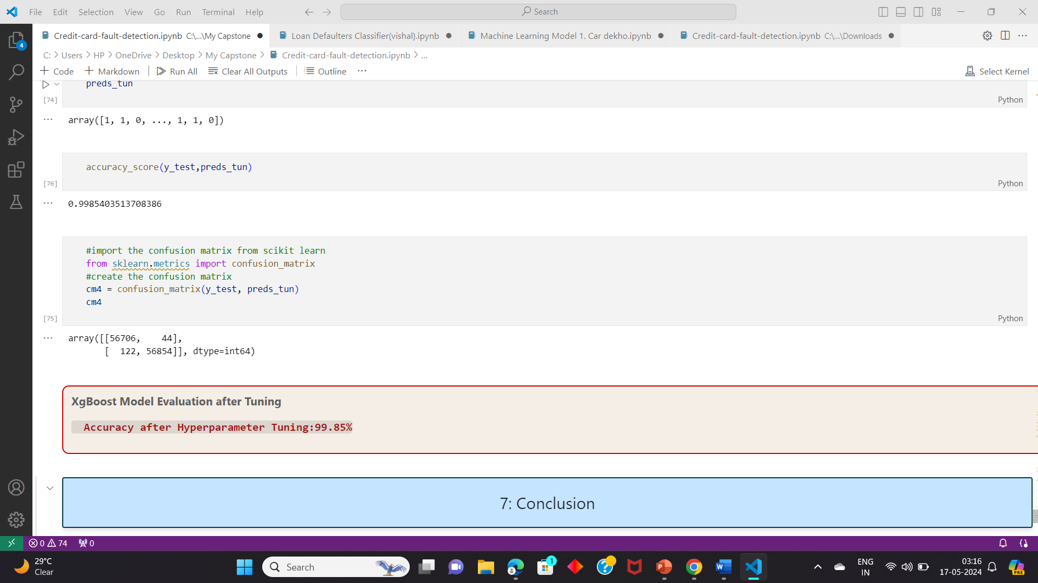
XgBoost….
Before Hyperparameter tuning.

Slide 14
Conclusion….
S.no | Model | Accuracy | Precision | Recall | F1 Score
0 | Logistic Regression | 0.981614 | 0.988101 | 0.975042 | 0.975042
1 | KNN | 0.999165 | 0.998335 | 1.0 | 1.0
2 | XGBoost | 0.990064 | 0.993775 | 0.986345 | 0.986345
🏆🏆KNN has the highest accuracy score of 99.99%....

Slide 15


Slide 16

Thank You……..
Submitted by: ISHA GOEL
7696899994

